Slide 1
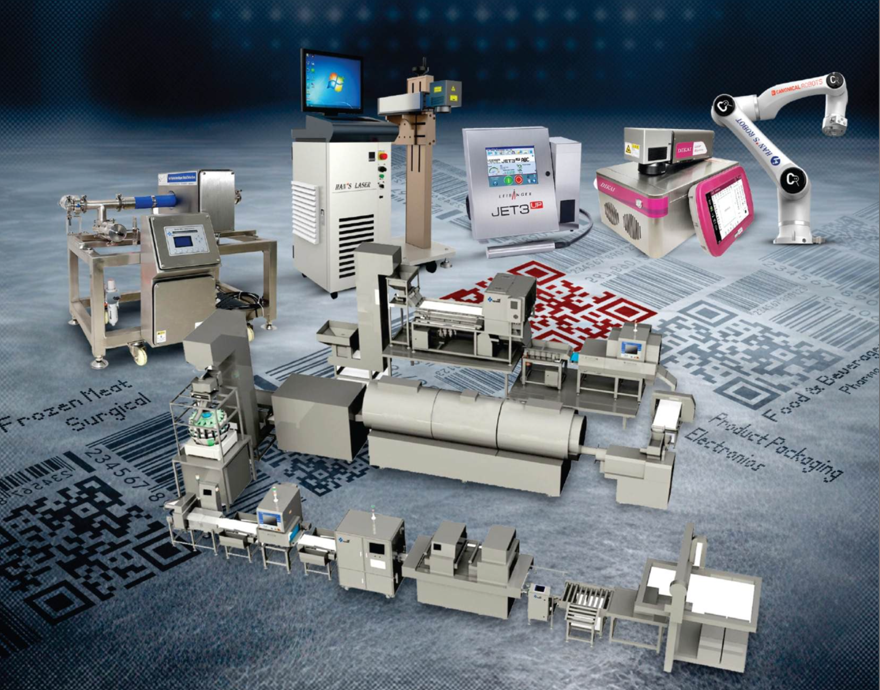

Automation Brain

Slide 2


Slide 3

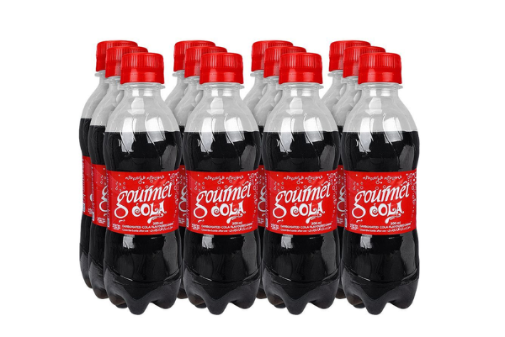
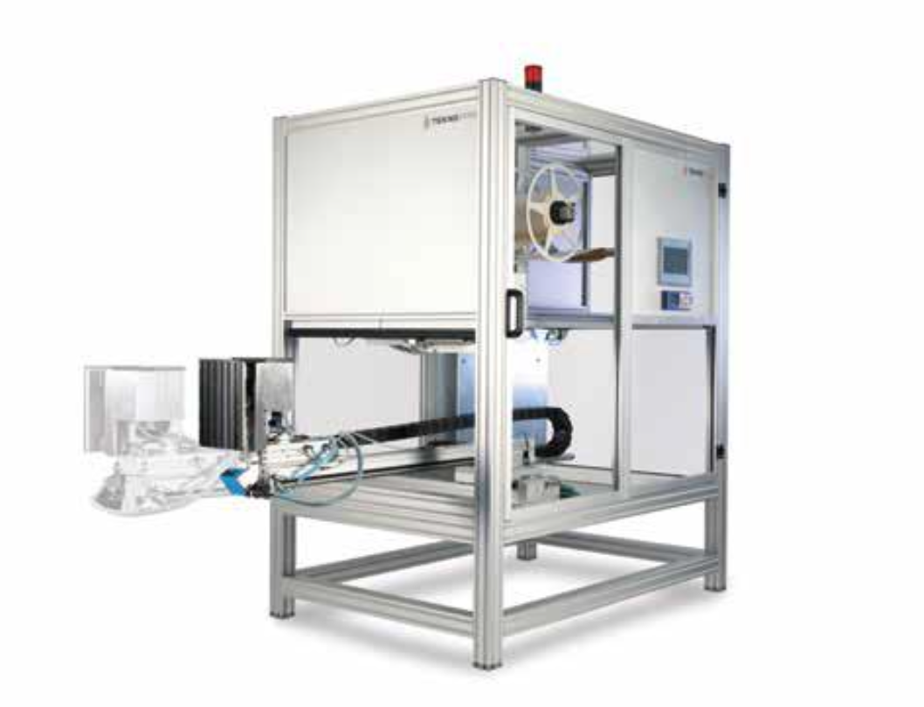
For End of Line Automation
Print and Apply system for Gourmet Pakistan
Pallet Labeller YYP-F with cabinet

Slide 4
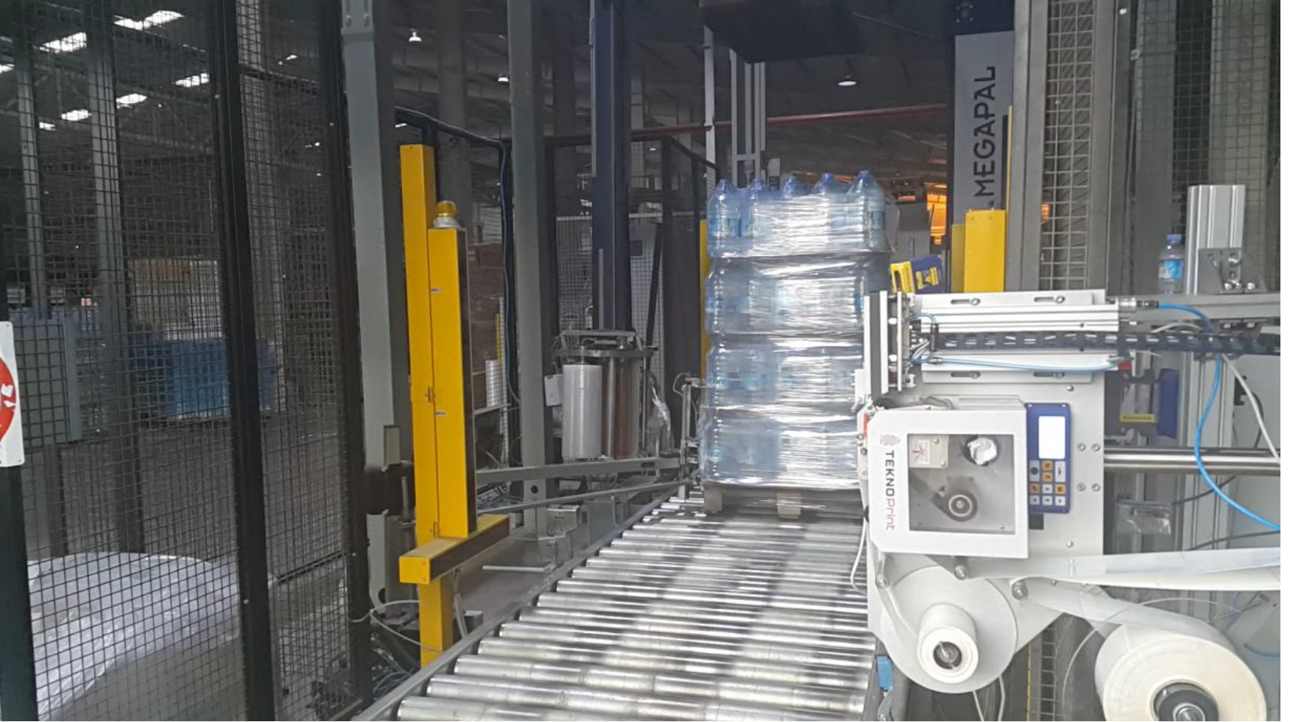

Slide 5
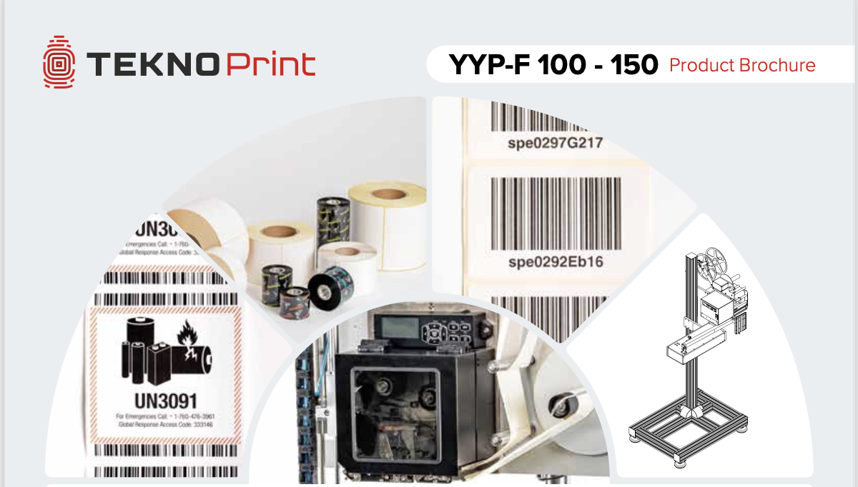
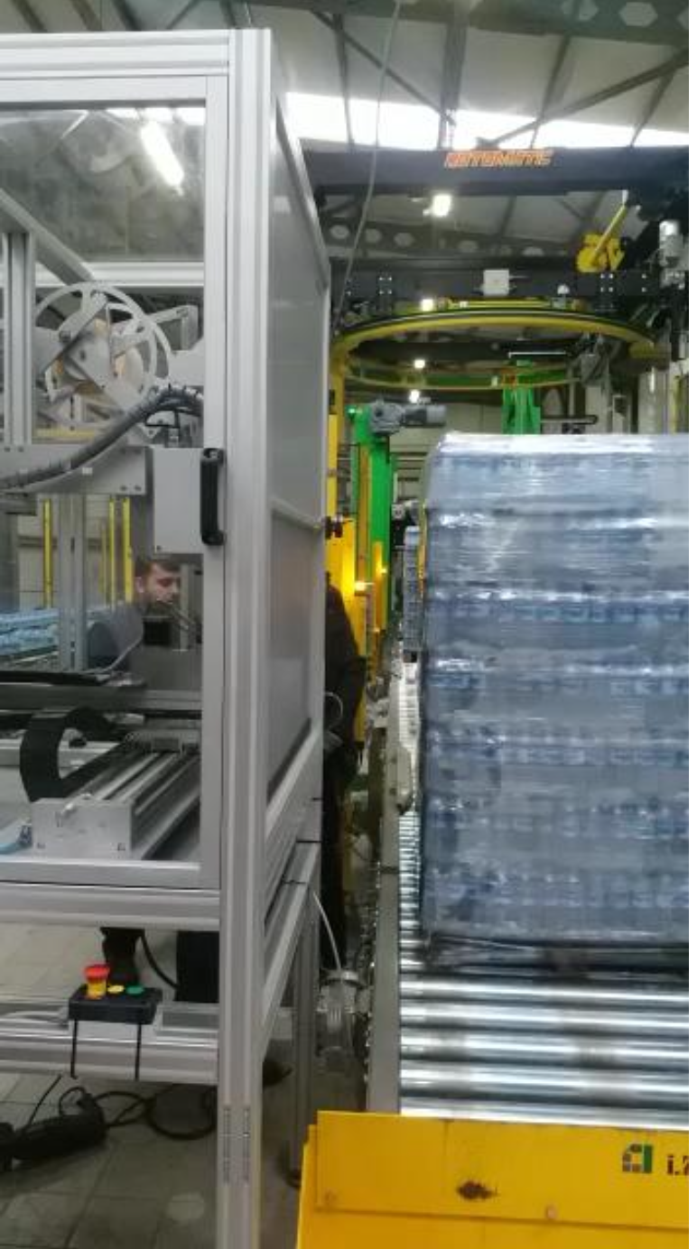
Technical Specifications
TECHNOPRINT is designed to meet the industry demands by supplying safe, affordable, easy-to-use and fast Print-and-Apply Labelling Machine.
Printer: TEKNOPRINT thermal transfer printer is produced by Carl Valentin in Germany.

Slide 6
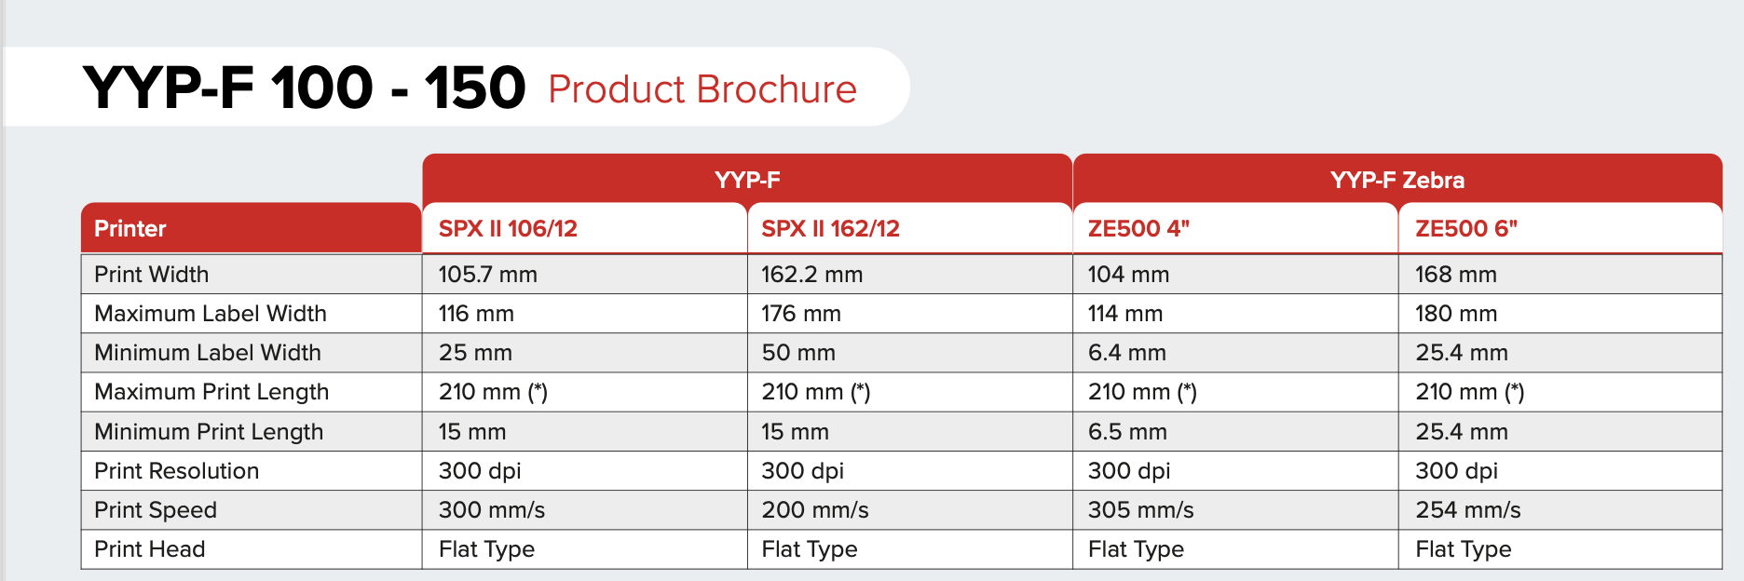
Applicator:
TEKNOPRINT Print-and-Apply Labeling Machine provides a choice of three high-quality models with tamp, dispanser and blow assist.

Slide 7
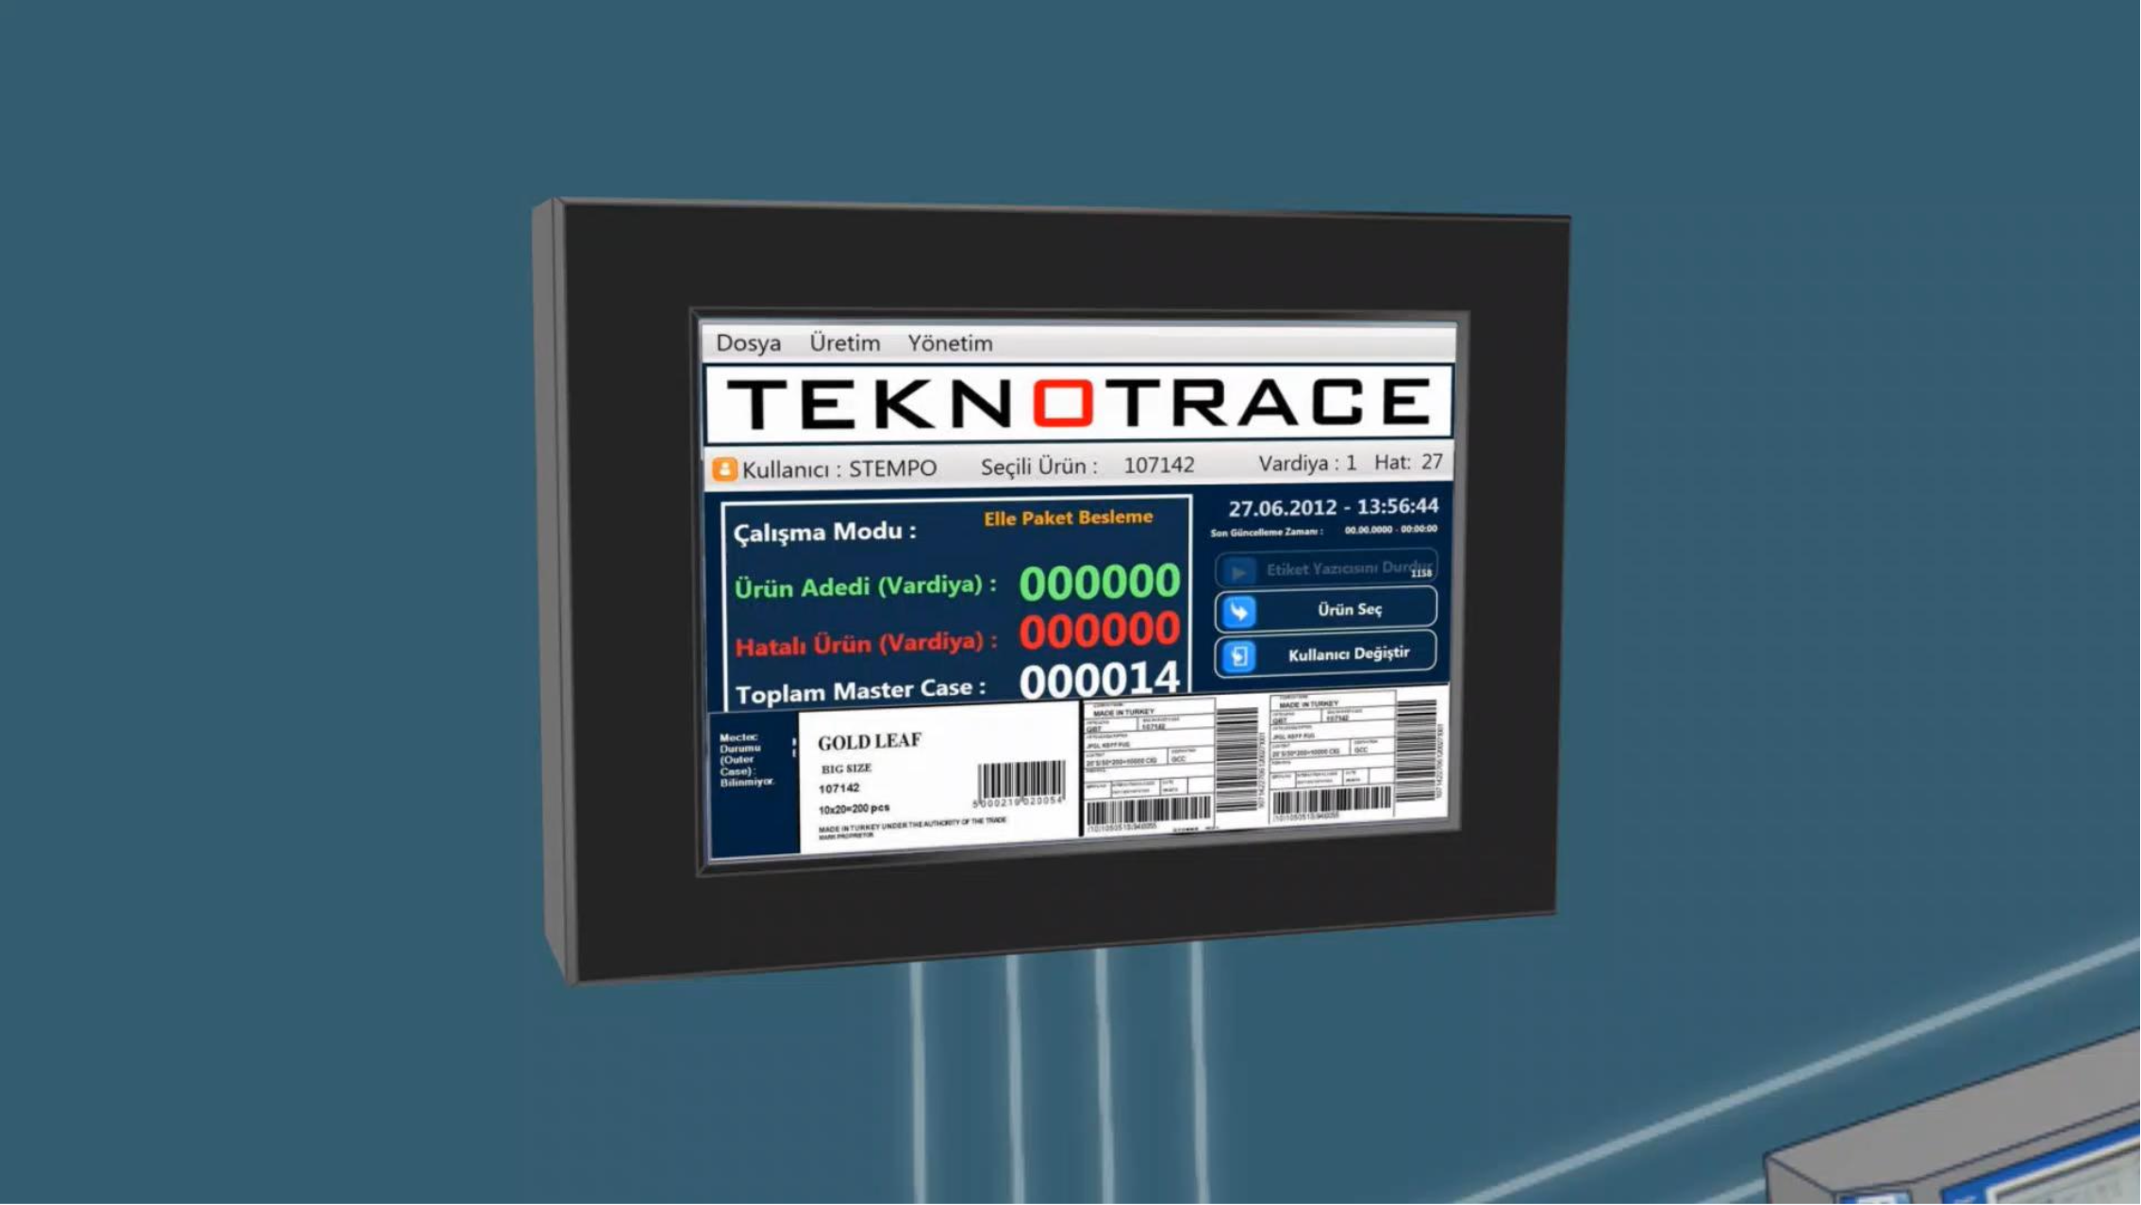
Customise Software with state of the art integration mode operational capabilities and intuitive user interface.

Slide 8
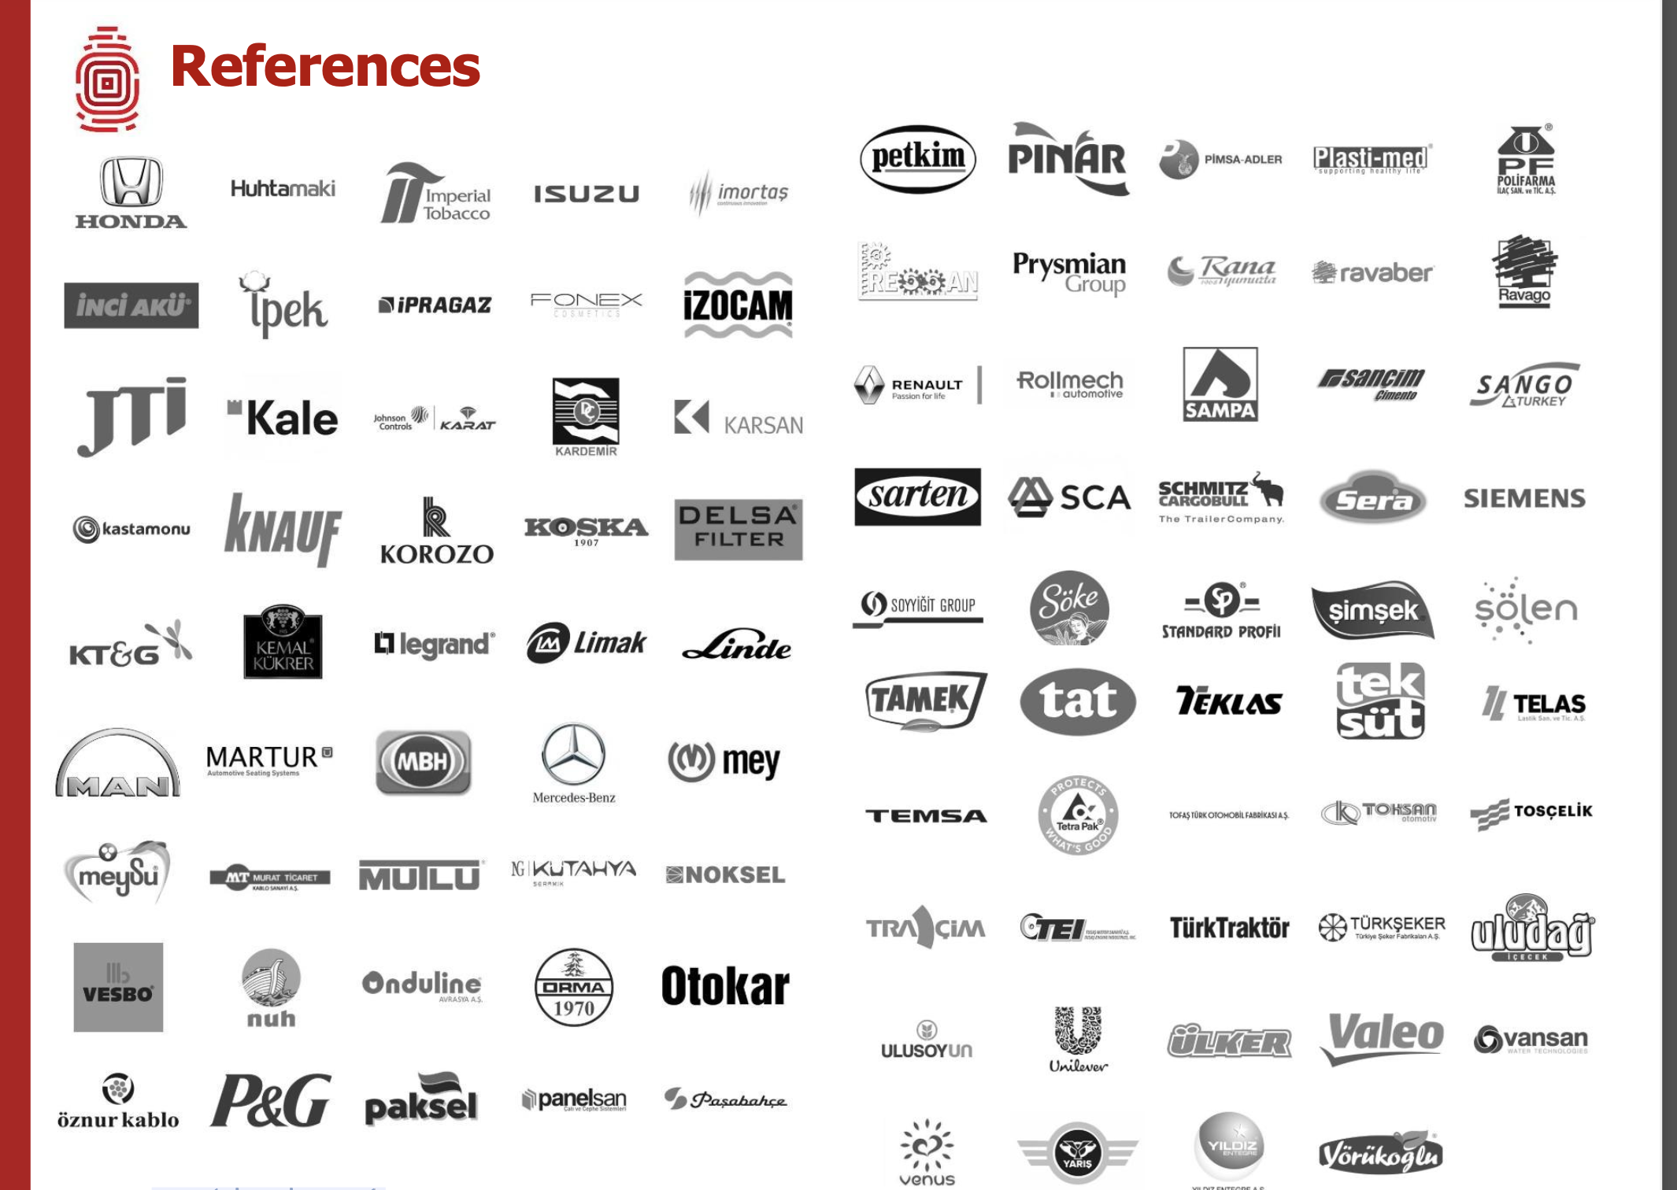
International Market references

Slide 9
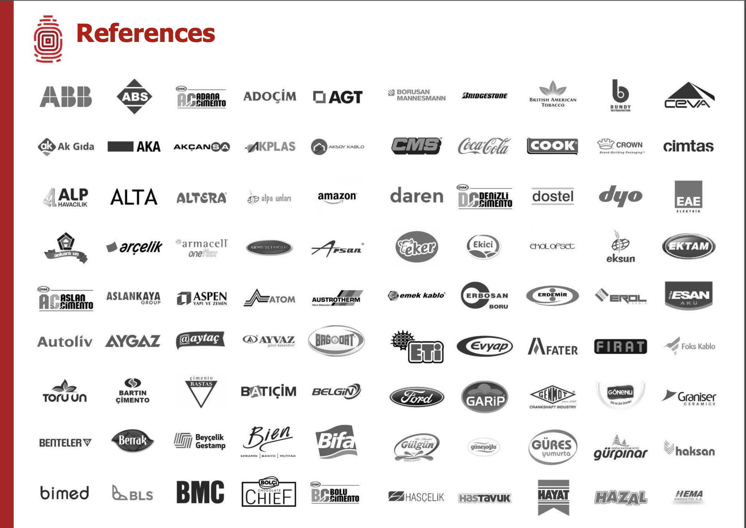
International Market references

Slide 10
Thank You
Automation Brain Pvt. Ltd.

